Slide 1
Historic Land Use

Slide 2
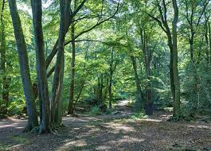
Britain after the last ice age

Slide 3
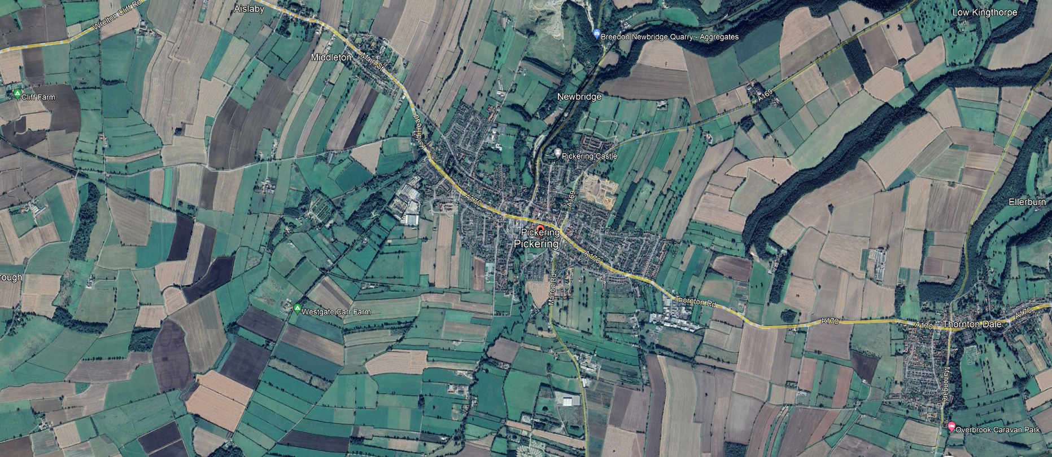
Pickering North Yorkshire

Slide 4
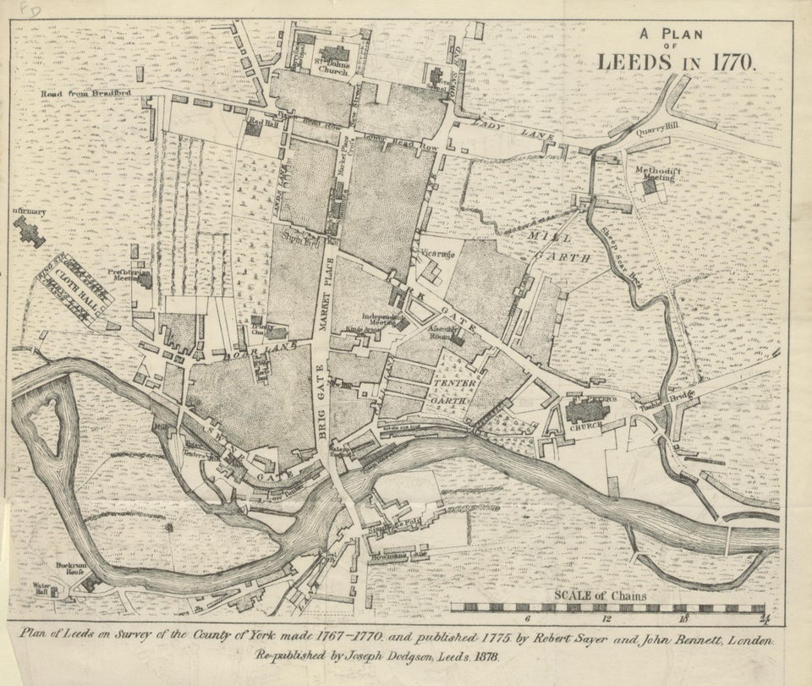
Preindustrial Leeds

Slide 5
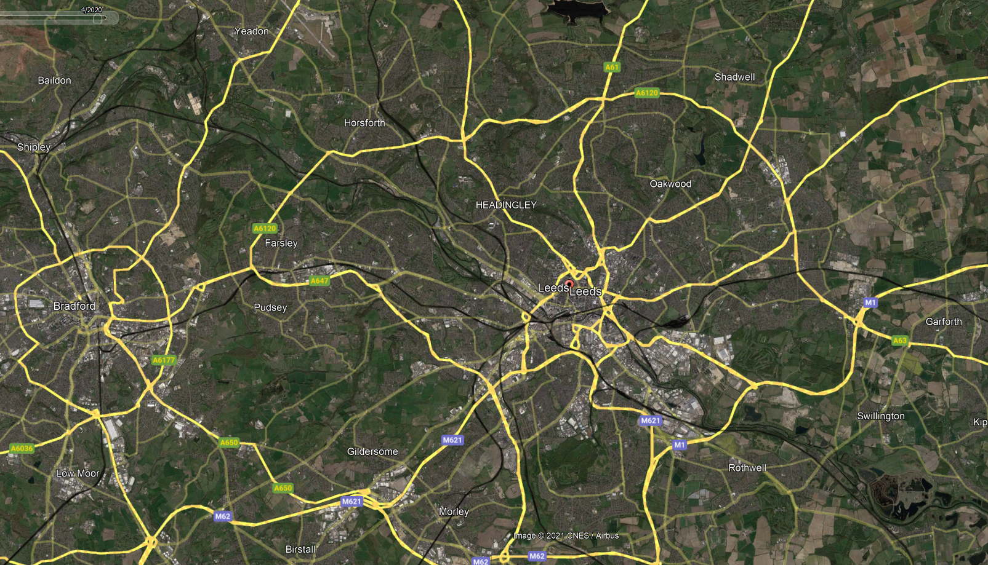
Leeds Today

Slide 6
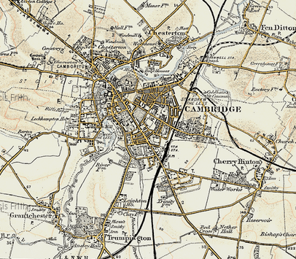
Cambridge 1899

Slide 7
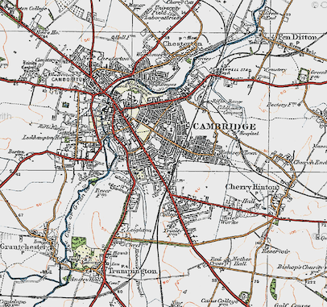
Cambridge 1920

Slide 8
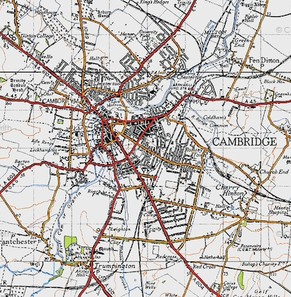
Cambridge 1946

Slide 9
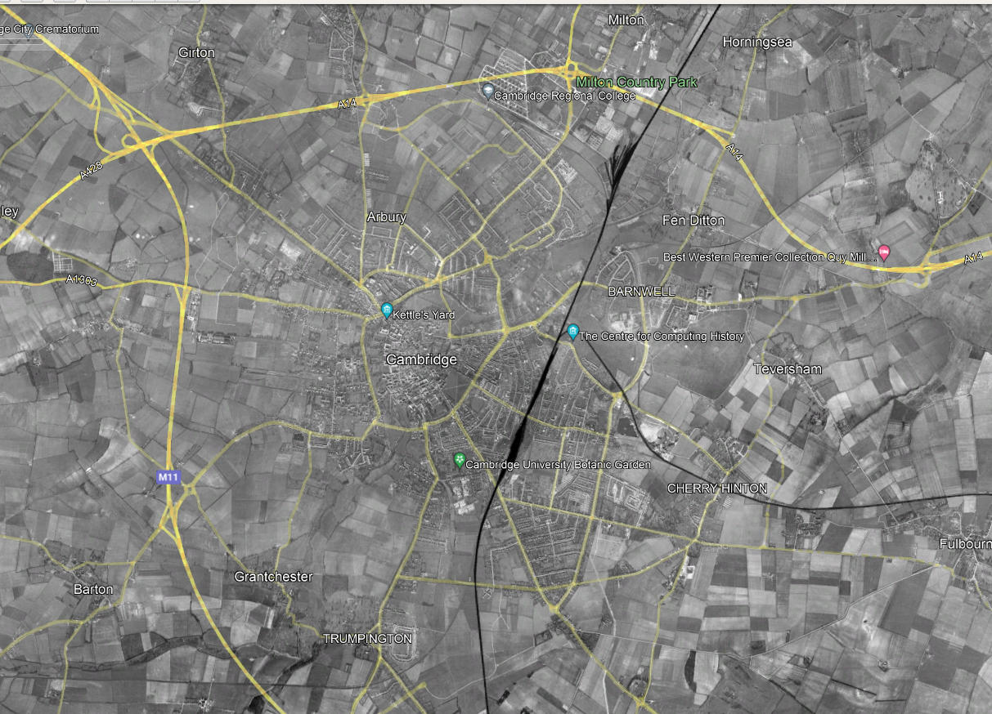
Cambridge 1945

Slide 10
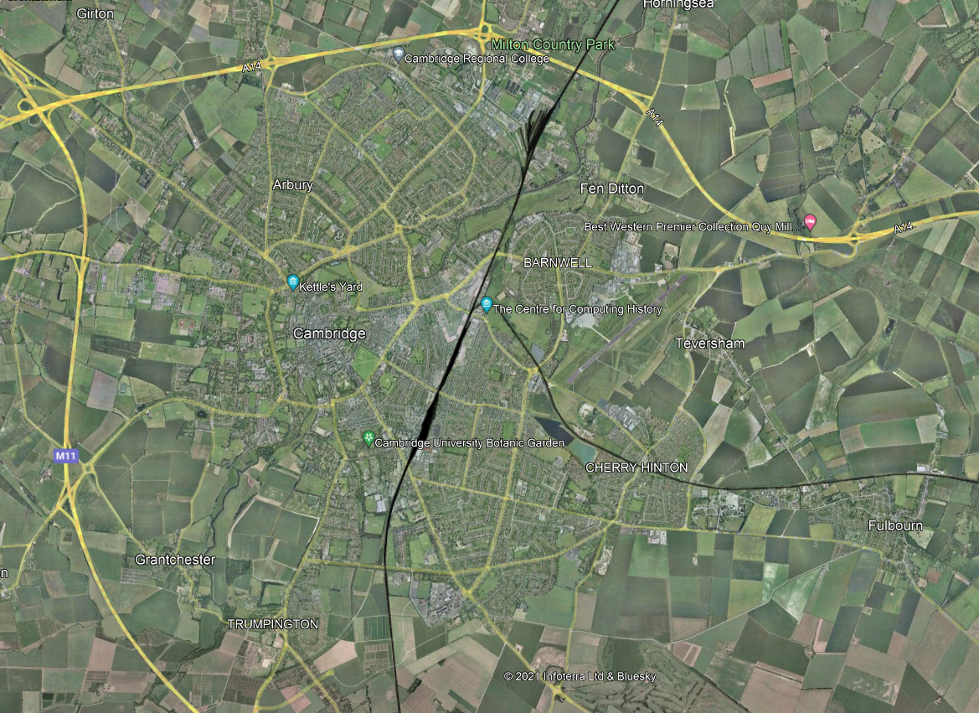
Cambridge 2000

Slide 11
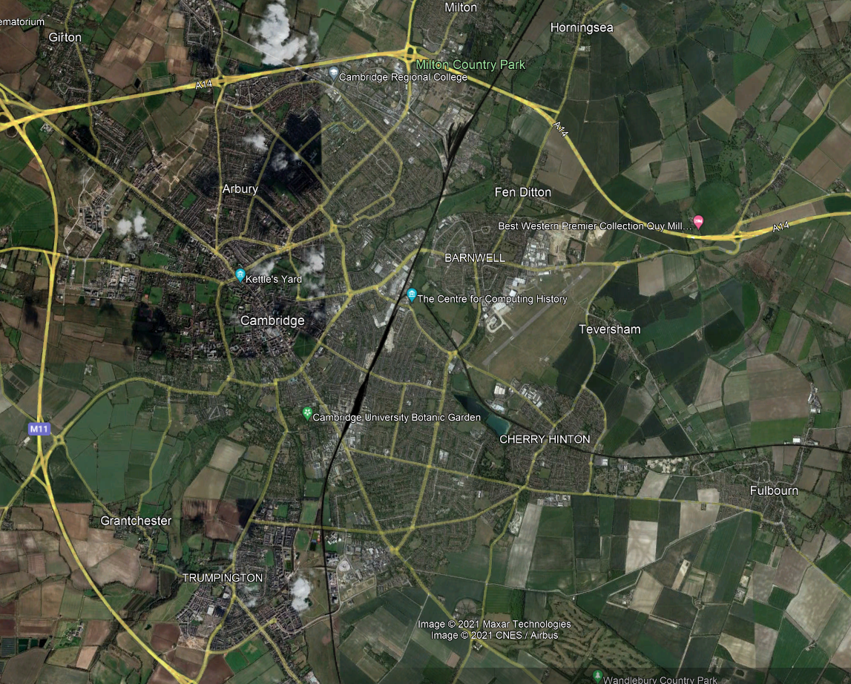
Cambridge 2021

Slide 12
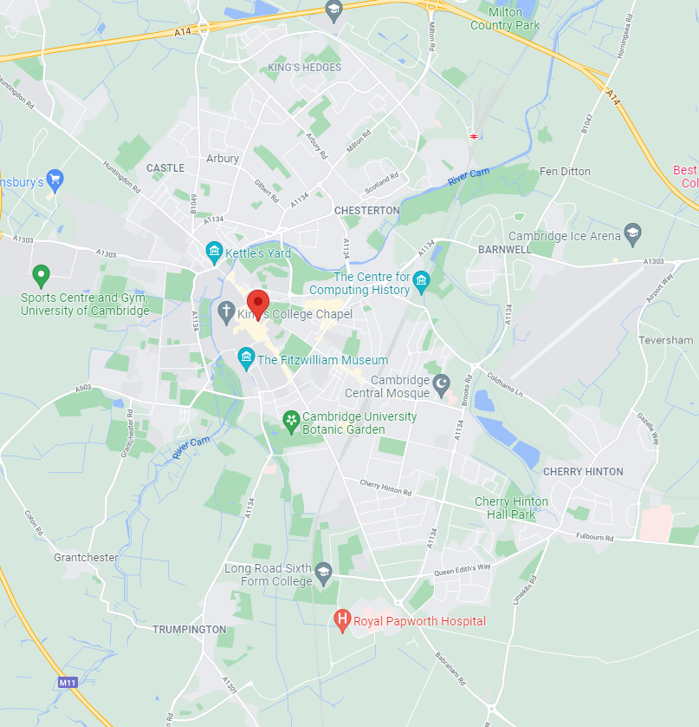
Cambridge 1899 - 2021

